Slide 1
Telangana Government Tourism Department
Proposal Insights

Slide 2
OVERVIEW OF THE PROJECT
The Telangana Government Tourism Department is responsible for promoting and developing tourism in the Indian state of Telangana. Its main objectives are to attract tourists to Telangana, create tourism infrastructure, and develop new tourism products. The department offers a variety of tourism services and facilities such as accommodation, transportation, and tour packages. It also organizes various events and festivals throughout the year to showcase the state's culture and heritage.

Slide 3
APPROACH THE PROBLEM
01
02
02
03
Preliminary Research Questions
Answers can be found directly from the given data.
Secondary Research Questions
Need to do research and get additional data.
Recommendations
Recommendations that can be provided to the government.

Slide 4
01
Preliminary Research QUESTIONS
Answers can be found directly from the given data.

Slide 5
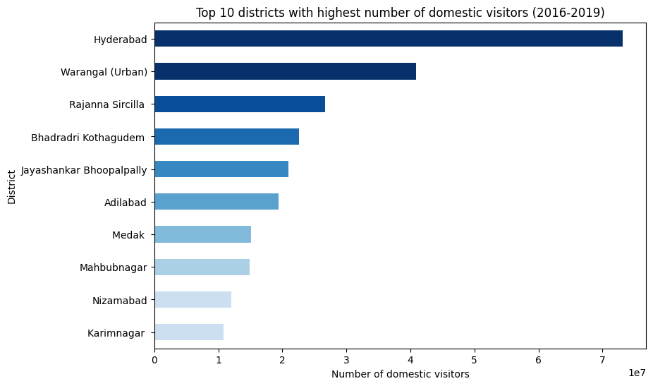
1. List down the top 10 districts that have the highest number of domestic visitors overall (2016 - 2019)?
(Insight: Get an overview of districts that are doing well)
Hyderabad is highest number of domestic visitors which is 73184713.
Warangal (Urban) is the second highest domestic visitors which is 40881415.
Karimnagar is the Top 10th domestic visitors which is 10798332.

Slide 6
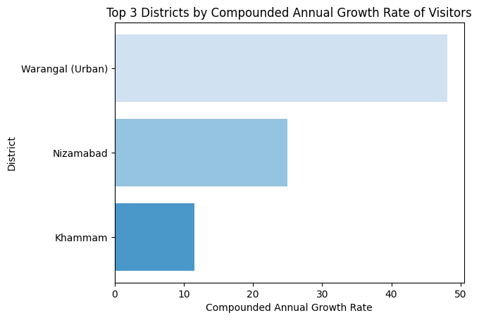
2. List down the top 3 districts based on compounded annual growth rate (CAGR) of visitor between (2016 - 2019)?
(Insight: Districts that are growing)
To calculate the compounded annual growth rate (CAGR) of visitors for each district between 2016-2019, we can use the following formula:
CAGR = (Ending value / Beginning value)^(1 / No. of years) - 1
We can start by grouping the data by district and then calculate the CAGR for each district based on the number of visitors between 2016-2019. Then we can sort the CAGR values in descending order to get the top 3 growing districts.

Slide 7
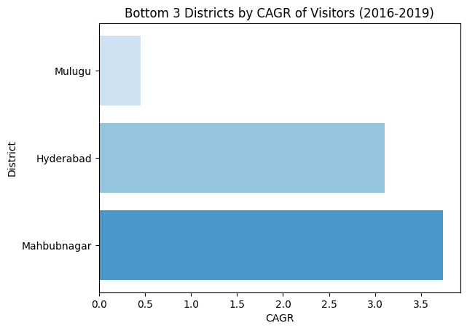
3. List down the bottom 3 districts based on compounded annual growth rate (CAGR) of visitors between
(2016-2019)? (Insight: Districts that are declining)
To calculate the compounded annual growth rate (CAGR) of visitors for each district between 2016-2019, we can use the following formula:
CAGR = (Ending value / Beginning value)^(1 / No. of years) - 1
We can start by grouping the data by district and then calculate the CAGR for each district based on the number of visitors between 2016-2019. Then we can sort the CAGR values in ascending order to get the bottom 3 decline districts.

Slide 8
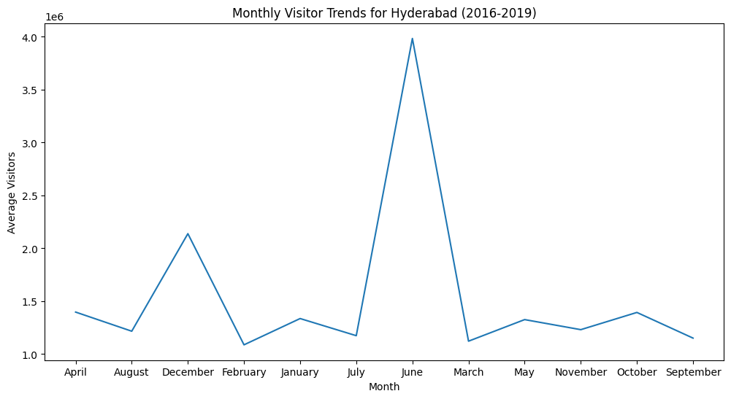
4. What are the peak and low season months for Hyderabad based on the data from 2016 to 2019 for Hyderabad district?
(Insight: Government can plan well for the peak seasons and boost low seasons by introducing new events)
The peak season month for Hyderabad is June, and the low season month is February.

Slide 9
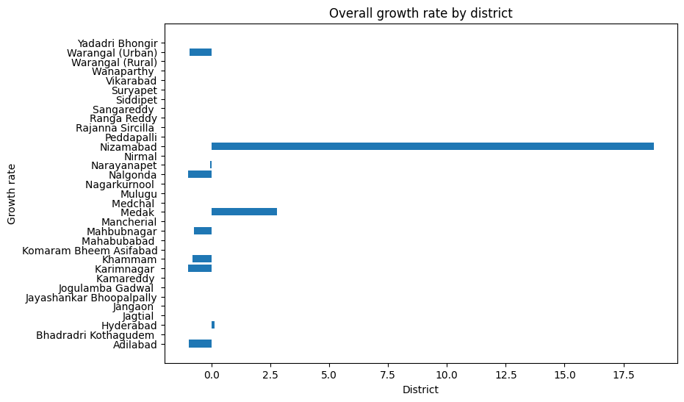
5. Show the top & bottom 3 districts with high domestic to foreign tourist ratio?
(Insight: Government can learn from top districts and replicate the same to bottom districts which can improve the foreign visitors as foreign visitors will bring more revenue)
Government should learn from top districts like Nizamabad, Medak and Hyderabad. And replicate the same models to others districts to increase the revenue of the state of Telangana.

Slide 10
02
Secondary Research QUESTIONS
Need to do research and get additional data

Slide 11
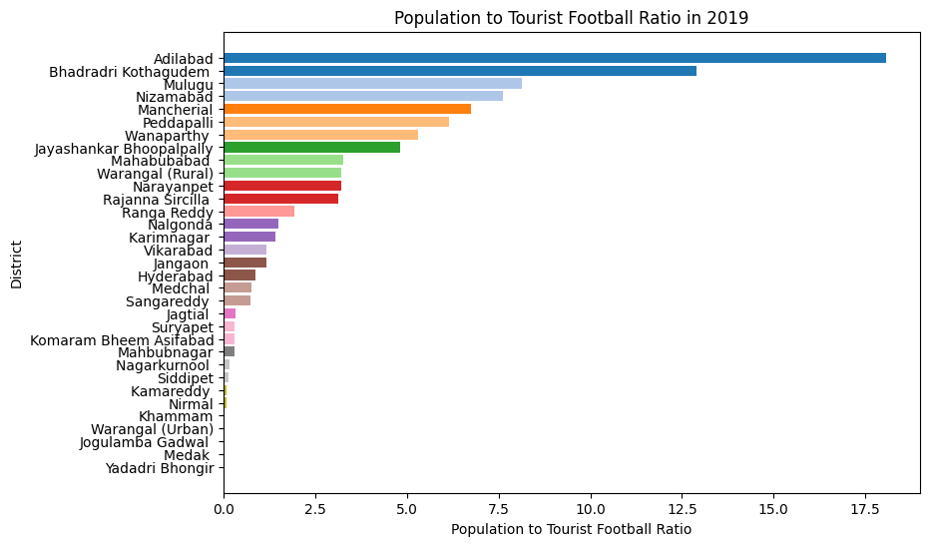
6. List of the top & bottom 5 districts based on 'population to tourist football ratio*' ratio in 2019 ?
(Insight: Get an overview of districts that are doing well)
Population census 2011 data has been used here to perform this task to find out the top and bottom 5 districts ratio of the population to tourist football ratio:
Adilabad is on top with 18.07 ratio.
second highest is Bhadradri Kothagudem with the ratio is 12.90.
Yadadri Bhangir last one with the ratio is 0.

Slide 12
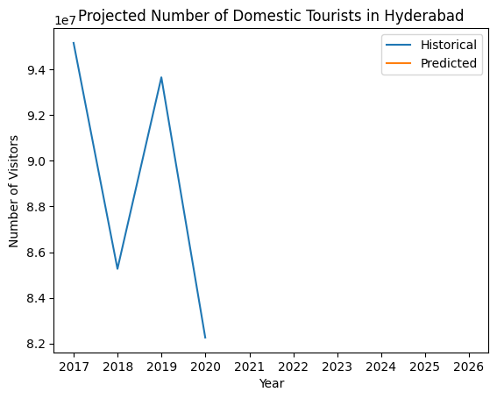
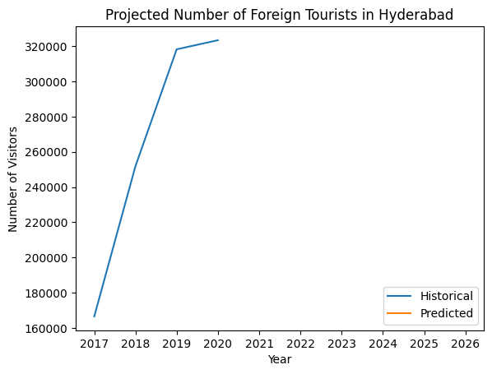
7. What will be the projected number of domestic and foreign tourists in Hyderabad in 2025 on growth rate from previous years?
(Insight: Better estimate of incoming tourists count so that government can plan the infrastructure better)
Projected number of domestic tourists in Hyderabad in 2025: 82259999
Projected number of foreign tourists in Hyderabad in 2025: 323326

Slide 13
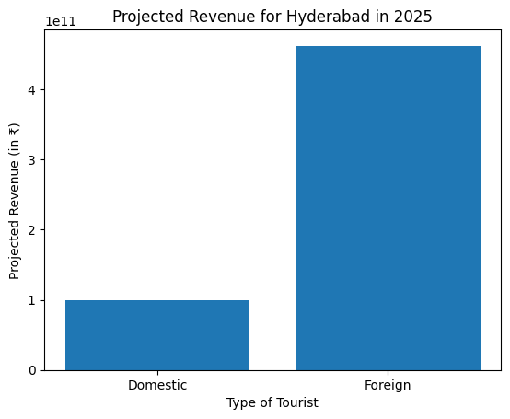
8. Estimate the projected revenue for Hyderabad in 2025 based on average spend per tourist (approximate data) Suggested areas for further secondary research to get more insights:
Crime rate, Cleanliness Ratings, Infrastructure Development Ratings etc.
TOURIST | AVERAGE REVENUE
Foreign Tourist | ₹ 5,600.00
Domestic Tourist | ₹ 1,200.00
Projected revenue for Hyderabad in 2025: ₹ 561566610000

Slide 14
03
Recommendations
Recommendations that can be provided to the government

Slide 15
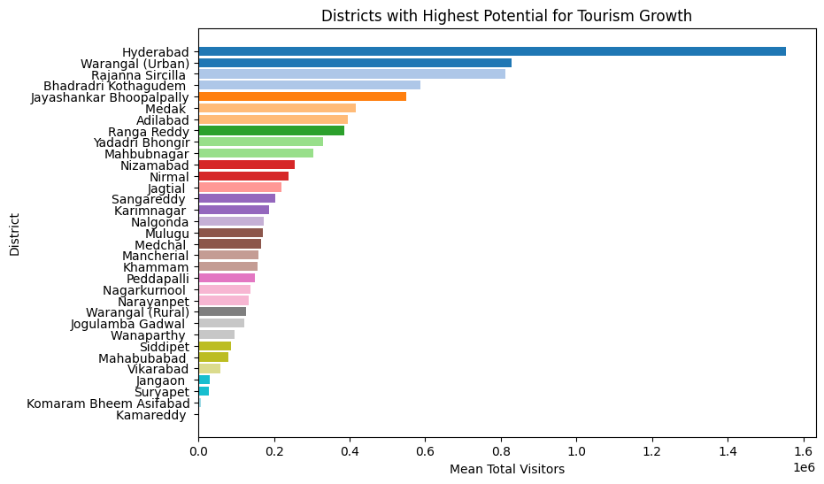
9. Districts with highest potential which districts has the highest potential for tourism growth and what actions government can take?
Top districts with highest potential is:
Hyderabad: Hyderabad is the capital city of Telangana and has a rich cultural and historical heritage. It is home to many historical monuments like the Charminar, Golconda Fort, and Chowmahalla Palace. The government can take several actions to promote tourism in Hyderabad, such as improving the infrastructure and facilities for tourists, promoting cultural festivals and events, and creating awareness about the city's heritage sites.

Slide 16
10. Cultural / Corporate Events to boost tourism
a)
b)
c)
What kind of events the government can conduct?
Which month(s)?
Which districts?

Slide 17
a). The government can conduct various cultural and corporate events to boost tourism, such as:
Music and dance festivals showcasing traditional and contemporary art forms
Food festivals highlighting the local cuisine
Cultural fairs showcasing local handicrafts and art forms
Film festivals promoting local cinema and tourism
Business conferences and exhibitions to attract corporate tourism

Slide 18
The choice of month(s) for conducting these events would depend on the type of event and the local weather conditions. For example, music and dance festivals could be conducted in the winter months from November to February when the weather is pleasant, while food festivals could be conducted during the monsoon season from July to September when local produce is abundant.
b)
c)
The choice of district(s) for conducting these events would depend on the local culture, heritage, and tourism potential. For example, districts with rich cultural heritage and art forms such as Hyderabad, Warangal, and Nizamabad could be selected for cultural festivals, while districts with a thriving business community such as Hyderabad and Rangareddy could be selected for corporate events.

Slide 19
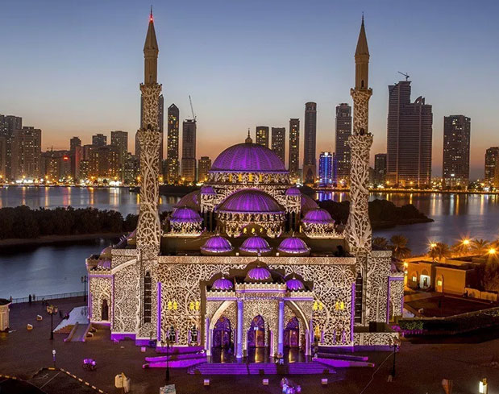
11. Dubai has made itself a business hub and enjoys massive business tourism. Can Hyderabad emulate the Dubai model? Provide insights based on your research.
Dubai has become a popular business hub and a major destination for business tourism due to its strategic location, world-class infrastructure, ease of doing business, and favorable tax policies. Hyderabad, on the other hand, has also made significant strides in recent years to attract businesses and investments.
To emulate the Dubai model, Hyderabad will need to focus on several areas such as:

Slide 20
Infrastructure: Hyderabad needs to continue investing in its infrastructure to attract businesses and visitors. This includes developing new airports, improving the road and rail networks, and upgrading the existing infrastructure.
Business-friendly policies: Hyderabad can follow Dubai's example of implementing business-friendly policies to attract investments and promote entrepreneurship. The government can offer tax incentives, simplify regulations, and provide a conducive business environment to encourage startups and companies to set up their base in Hyderabad.
Marketing and promotion: Dubai has effectively marketed itself as a destination for business tourism through a well-coordinated marketing campaign that includes targeted advertising, events, and public relations. Hyderabad can also invest in promoting its business potential to attract investors and businesses.

Slide 21
Events and conferences: Dubai has been successful in attracting business travelers by hosting a wide range of international conferences and exhibitions. Hyderabad can emulate this model by hosting similar events and conferences that are relevant to its target industries, such as IT, pharmaceuticals, and biotechnology.
Skill development: Dubai has invested heavily in developing the skills of its workforce to meet the demands of the growing business tourism sector. Hyderabad can also focus on developing the skills of its workforce to cater to the needs of the growing business and tourism sectors.
  In conclusion, while there are certainly lessons to be learned from Dubai's success, Hyderabad needs to create its unique identity and tailor its approach to the local context. With the right investments and policies, Hyderabad can certainly emulate Dubai's success and become a leading destination for business tourism.

Slide 22

A PICTURE IS WORTH A THOUSAND WORDS

Slide 23
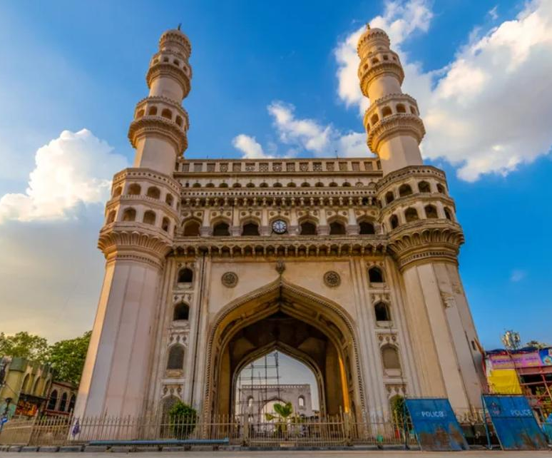
12. Provide all other recommendations that can boost the Telangana tourism, particularly Hyderabad.
Promote Heritage Tourism: Telangana is rich in heritage and has several historical monuments and landmarks, such as Charminar, Golconda Fort, and the Qutub Shahi Tombs. The government can promote heritage tourism by organizing heritage walks, developing audio guides, and creating informative brochures.

Slide 24
Develop Adventure Tourism: Telangana has many adventure activities, such as trekking, camping, and river rafting. The government can develop infrastructure to promote adventure tourism, such as building trekking and camping sites, organizing adventure sports events, and creating adventure packages for tourists.
Promote Rural Tourism: Rural tourism has become a popular trend worldwide, where tourists visit rural areas to experience local culture, customs, and traditions. The government can promote rural tourism in Telangana by creating rural tour packages, organizing village fairs, and supporting the development of local handicrafts.
Develop Medical Tourism: Hyderabad is home to several world-class hospitals and medical institutions. The government can develop medical tourism by promoting the city as a medical hub and creating special packages for medical tourists, including discounted rates for medical treatments, accommodation, and transport.

Slide 25
Promote Food Tourism: Hyderabad is known for its delicious cuisine, such as biryani, haleem, and kebabs. The government can promote food tourism by organizing food festivals, creating food trails, and supporting the development of local restaurants and street food vendors.
Develop MICE Tourism: Hyderabad is home to several world-class convention centers, such as the Hyderabad International Convention Centre (HICC) and HITEX Exhibition Centre. The government can develop MICE (Meetings, Incentives, Conferences, and Exhibitions) tourism by promoting the city as a destination for business events and conferences.

Slide 26
Develop Sustainable Tourism: The government can develop sustainable tourism practices to ensure that the tourism industry does not harm the environment and local communities. This can be achieved by promoting eco-tourism, creating guidelines for responsible tourism practices, and supporting the development of sustainable tourism infrastructure.
Increase Marketing Efforts: The government can increase its marketing efforts to promote Telangana tourism to both domestic and international tourists. This can be done by creating attractive tourism packages, creating a strong social media presence, and partnering with travel agencies and tour operators.

Slide 27
THANKS!
Presented by:
MAYUR KORDE

